Slide 1
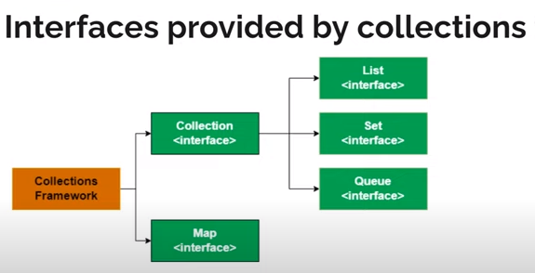

Slide 2
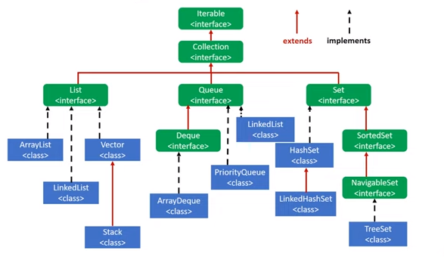
Hierarchy of Collection Interface

Slide 3
Set Inteface
The set interface is present in java.util package and extends the Collection interface.
It is an unordered collection of objects in which duplicate values cannot be stored.
It is an interface that implements the mathematical set.
This interface contains the methods inherited from the Collection interface and adds a feature that restricts the insertion of the duplicate elements.

Slide 4
add(element) | This method is used to add a specific element to the set
addAll(collection) | This method is used to append all of the elements from the mentioned collection to the existing set.
clear() | This method is used to remove all the elements from the set but not delete the set. The reference for the set still exists.
contains(element) | This method is used to check whether a specific element is present in the Set or not.
containsAll(collection) | This method is used to check whether the set contains all the elements present in the given collection or not. This method returns true if the set contains all the elements and returns false if any of the elements are missing.
hashCode() | This method is used to get the hashCode value for this instance of the Set. It returns an integer value which is the hashCode value for this instance of the Set.
isEmpty() | This method is used to check whether the set is empty or not.
iterator() | This method is used to return the iterator of the set. The elements from the set are returned in a random order.
remove(element) | This method is used to remove the given element from the set. This method returns True if the specified element is present in the Set otherwise it returns False.
removeAll(collection) | This method is used to remove all the elements from the collection which are present in the set. This method returns true if this set changed as a result of the call.
retainAll(collection) | This method is used to retain all the elements from the set which are mentioned in the given collection. This method returns true if this set changed as a result of the call.
size() | This method is used to get the size of the set. This returns an integer value which signifies the number of elements.
toArray() | This method is used to form an array of the same elements as that of the Set.

Slide 5
Operations on the Set Interface
On the Set, we can perform all the basic mathematical operations like intersection, union and difference.
In set, addAll() method is used to perform the union
retainAll() method is used to perform the intersection
removeAll() method is used to perform difference.

Slide 6
HashSet
HashSet class which is implemented in the collection framework is an inherent implementation of the hash table data structure.
The objects that we insert into the HashSet do not guarantee to be inserted in the same order.
The objects are inserted based on their hashcode.
This class also allows the insertion of NULL elements.
It does not allow the duplicate values.

Slide 7
//implementing Hashset
import java.util.*;
public class SetOperations {
public static void main(String args[]) {
Integer[] A = {22, 45,33, 66, 55, 34, 77};
Integer[] B = {33, 2, 83, 45, 3, 12, 55};
Set<Integer> set1 = new HashSet<Integer>();
set1.addAll(Arrays.asList(A));
Set<Integer> set2 = new HashSet<Integer>();
set2.addAll(Arrays.asList(B));
Set<Integer> union_data = new HashSet<Integer>(set1);
union_data.addAll(set2);
System.out.print("Union of set1 and set2 is:"+union_data);
Set<Integer> intersection_data = new HashSet<Integer>(set1); intersection_data.retainAll(set2);
System.out.print("Intersection of set1 and set2 is:"+intersection_data);
Set<Integer> difference_data = new HashSet<Integer>(set1);
difference_data.removeAll(set2);
System.out.print("Difference of set1 and set2 is:"+difference_data);
} }

Slide 8
TreeSet
TreeSet class which is implemented in the collections framework and implementes Set Interface.
It stores elements in a sorted format.
TreeSet uses a tree data structure for storage.
Objects are stored in sorted, ascending order. But we can iterate in descending order using the method TreeSet.descendingIterator().

Slide 9
//Implementing TreeSet Class
import java.util.Set;
import java.util.TreeSet;
import java.util.Iterator;
class Main {
public static void main(String[] args) {
Set<Integer> numbers = new TreeSet<>();
numbers.add(2);
numbers.add(3);
numbers.add(1);
System.out.println("Set using TreeSet: " + numbers);
// Access Elements using iterator()
System.out.print("Accessing elements using iterator(): ");
Iterator i = numbers.iterator();
while(i.hasNext()) {
System.out.print(i.next());
} } }

Slide 10
LinkedHashSet
LinkedHashSet class which is implemented in the collections framework is an ordered version of HashSet that maintains a doubly-linked List across all elements.
LinkedHashSet maintains the iteration order
When iterating through a HashSet the order is unpredictable, while a LinkedHashSet lets us iterate through the elements in the order in which they were inserted

Slide 11
import java.util.*;
class Test {
public static void main(String[] args) {
Set<String> lh = new LinkedHashSet<String>();
lh.add("India");
lh.add("Australia");
lh.add("South Africa");
lh.add("India");
System.out.println(lh);
lh.remove("Australia");
System.out.println("Set after removing "+"Australia:" + lh);
// Iterating over linked hash set items
System.out.println("Iterating over set:");
Iterator i = lh.iterator();
while (i.hasNext())
System.out.println(i.next());
} }

Slide 12
Iterator vs ListIterator
An Iterator is an interface in Java and we can traverse the elements of a list in a forward direction.
ListIterator is an interface that extends the Iterator interface and we can traverse the elements in both forward and backward directions.
An Iterator can be used in these collection types like List, Set, and Queue whereas ListIterator can be used in List collection only.
The important methods of Iterator interface are hasNext(), next() and remove()
important methods of ListIterator interface are add(), hasNext(), hasPrevious() and remove().

Slide 13
//Iterator
List<String> listObject = new ArrayList<String>();
listObject.add("India");
Iterator it = listObject.iterator();
while (it.hasNext()) {
System.out.println(it.next()); }
//ListIterator
List<String> listObject = new ArrayList<String>();
listObject.add("Java");
listObject.add("Selenium");
ListIterator it = listObject.listIterator();
System.out.println("Iterating the elements in forward direction: ");
while (it.hasNext()) {
System.out.println(it.next()); }
System.out.println("Iterating the elements in backward direction: ");
while (it.hasPrevious()) {
System.out.println(it.previous());

Slide 14
Map Interface
The map interface is present in java.util package represents a mapping between a key and a value.
The Map interface is not a subtype of the Collection interface.
A map contains unique keys.
Maps are perfect to use for key-value association mapping such as dictionaries.
The maps are used to perform lookups by keys or when someone wants to retrieve and update elements by keys.
Some common scenarios are as follows:
A map of error codes and their descriptions.
A map of zip codes and cities.
A map of managers and employees. Each manager (key) is associated with a list of employees (value) he manages.
A map of classes and students. Each class (key) is associated with a list of students (value).
Since Map is an interface, objects cannot be created of the type map. We always need a class that extends this map in order to create an object

Slide 15
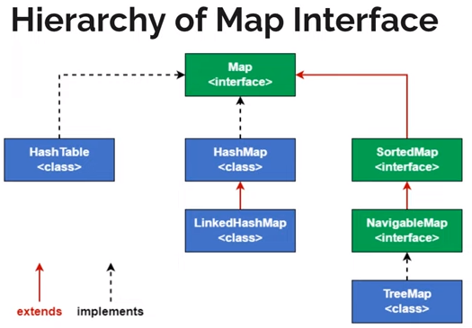

Slide 16
Methods
clear(): This method is used to clear and remove all of the elements
containsKey(Object): This method is used to check whether a particular key is being mapped into the Map or not
equals(Object): This method is used to check for equality between two maps.
get(Object): This method is used to retrieve or fetch the value mapped by a particular key mentioned in the parameter. It returns NULL when the map contains no such mapping for the key.
hashCode(): This method is used to generate a hashCode for the given map containing keys and values.
isEmpty(): This method is used to check if a map is having any entry for key and value pairs.
keySet()This method is used to return a Set view of the keys contained in this map.
put(Object, Object)This method is used to associate the specified value with the specified key in this map.

Slide 17
putAll(Map)This method is used to copy all of the mappings from the specified map to this map.
remove(Object)This method is used to remove the mapping for a key from this map if it is present in the map.
size()This method is used to return the number of key/value pairs available in the map.
The java.util.HashMap.entrySet() method in Java is used to create a set out of the same elements contained in the hash map.

Slide 18
import java.util.*;
class Main {
public static void main(String args[]) {
Map<String, Integer> hm= new HashMap<String, Integer>();
hm.put("a", 100);
hm.put("b“,200);
hm.put("c", 300);
hm.put("d", 400);
// Traversing through Map using for-each loop
for (Map.Entry<String, Integer> me :hm.entrySet()) {
System.out.print(me.getKey() + ":");
System.out.println(me.getValue());
}
}
}

Slide 19
HashMap
HashMap is a part of Java’s collection since Java 1.2. It provides the basic implementation of the Map interface of Java.
It stores the data in (Key, Value) pairs. To access a value one must know its key.
This class uses a technique called Hashing.
Hashing is a technique of converting a large String to a small String that represents the same String.
A shorter value helps in indexing and faster searches.

Slide 20
import java.util.*;
public class Test {
public static void main(String[] args) {
// Creating an empty HashMap
Map<String, Integer> map = new HashMap<>();
//Map<Integer,String> map = new HashMap<>();
// Inserting entries in the Map
// using put() method
map.put("vishal", 10);
map.put("sachin", 30);
map.put("vaibhav", 20);
// Iterating over Map
for (Map.Entry e : map.entrySet())
// Printing key-value pairs
System.out.println(e.getKey() + " “+ e.getValue());
}
}

Slide 21
LinkedHashMap
LinkedHashMap is just like HashMap with an additional feature of maintaining an order of elements inserted into it.
HashMap provided the advantage of quick insertion, search, and deletion but it never maintained the track and order of insertion which the LinkedHashMap provides where the elements can be accessed in their insertion order.

Slide 22
import java.util.*;
public class Test {
public static void main(String[] args) {
Map<String, Integer> map = new LinkedHashMap<>();
map.put("vishal", 10);
map.put("sachin", 30);
map.put("vaibhav", 20);
for (Map.Entry<String, Integer> e : map.entrySet())
System.out.println(e.getKey() + " "+ e.getValue());
}
}

Slide 23
TreeMap
The TreeMap in Java is used to implement Map interface and NavigableMap along with the AbstractMap Class.
The map is sorted according to the natural ordering of its keys, or by a Comparator provided at map creation time, depending on which constructor is used.
This proves to be an efficient way of sorting and storing the key-value pairs.
The storing order maintained by the treemap must be consistent with equals just like any other sorted map, irrespective of the explicit comparators.
The TreeMap implementation is not synchronized in the sense that if a map is accessed by multiple threads, concurrently and at least one of the threads modifies the map structurally, it must be synchronized externally.

Slide 24
import java.util.*;
class Test{
public static void main(String args[]){
Map<Integer,String> m=new TreeMap<Integer,String>();
m.put(10,"abhi");
m.put(new Integer(20),"avi");
m.put(30,"ruhi");
m.put(50,"xyz");
System.out.println(m);
m.put(20,"abc");
System.out.println(m);
m.remove(20);
System.out.println(m);
//iterating over the list
for (Map.Entry e : m.entrySet()) {
System.out.println(e.getKey() + " : " + e.getValue());
} } }

